Slide 1

Just Git it
Prepared by – Sumit Agrawal

Slide 2
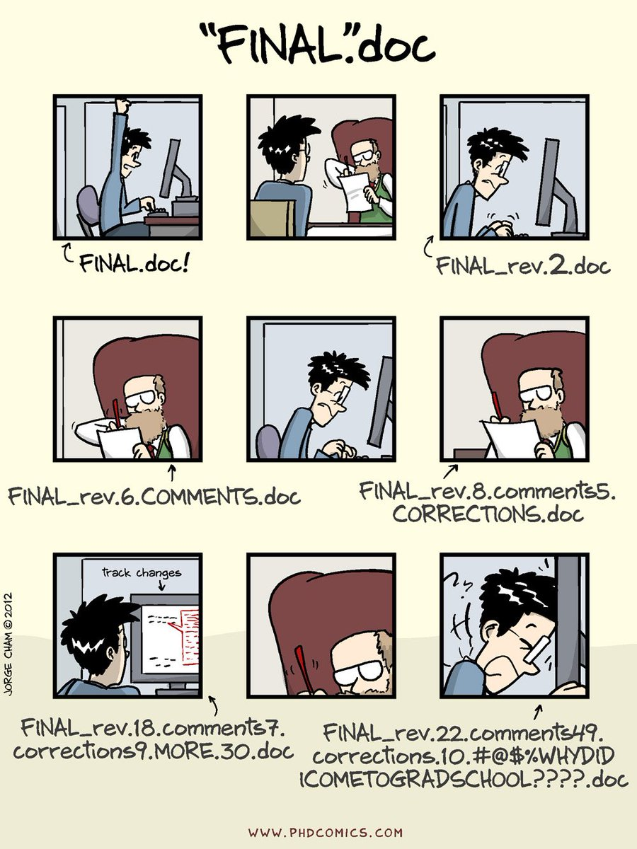
Why git
Version Control
Save work
Review Changes
Do not lose history
Share with others
Reduce mental burden
Working in collaboration
Ref:- SDE course lecture notes, Instructor: Prabhu Ramachandran

Slide 3
Installation on Windows
Git Bash – Command Prompt specifically designed for windows
(https://git-for-windows.github.io/) {during installation path – use gitbash only}
Youtube video (https://www.youtube.com/watch?v=_tN0T7jYn0A)
Configure the git bash
(https://git-scm.com/book/en/v2/Getting-Started-First-Time-Git-Setup)
Username and user email must be same as in used in github.com

Slide 4
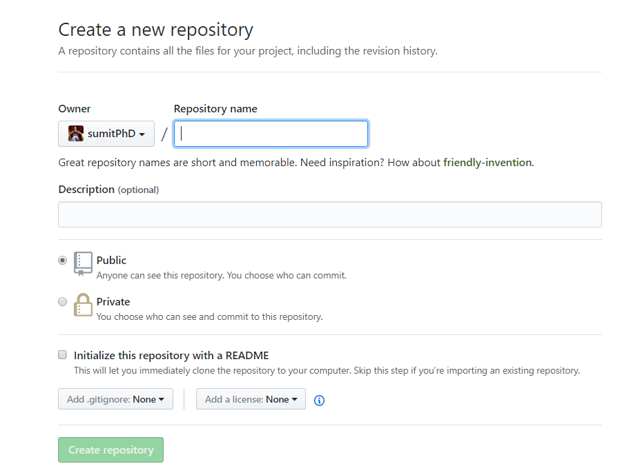
GitHub
Create and account on github (https://github.com/)
To add an existing project on github follow this. (https://help.github.com/articles/adding-an-existing-project-to-github-using-the-command-line/)
Public Repository (Free – open)
Private Repository (create account with iitb mail id – get 2 year of subscription free, after that 7$ per month)
Storage(no limitation on number of repository. Repository size<1GB)

Slide 5
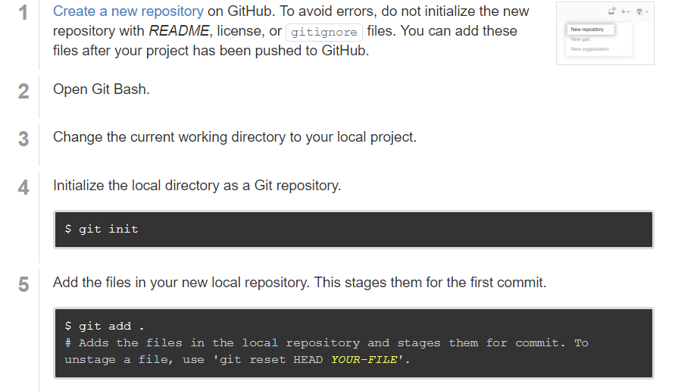

Slide 6
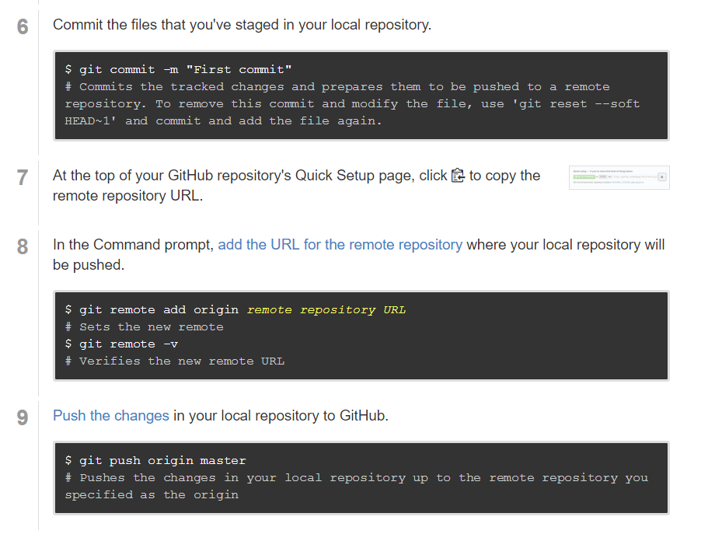

Slide 7
EDITOR PAIN
Download sublime editor
Make sublime default editor for git bash(https://stackoverflow.com/questions/8951275/how-can-i-make-sublime-text-the-default-editor-for-git)
git config --global core.editor "'c:/program files/sublime text 2/sublime_text.exe' -w"
Sync PAIN
If it happens, refer
https://www.atlassian.com/git/tutorials/syncing

Slide 8
Commands
git init
git add abc.m
git status
git commit
git log
git diff abcCommit1 abcCommit2
git remote add origin <remote>
git push origin master
git pull <remote>
git ignore

Slide 9
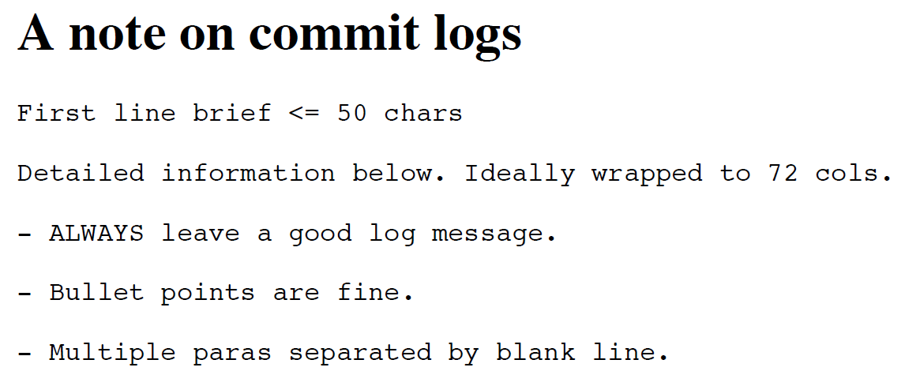

Slide 10
Further Reading
Fetch
Branching
merge
Udacity Course – How to use git and github
https://in.udacity.com/course/how-to-use-git-and-github--ud775/

Slide 11
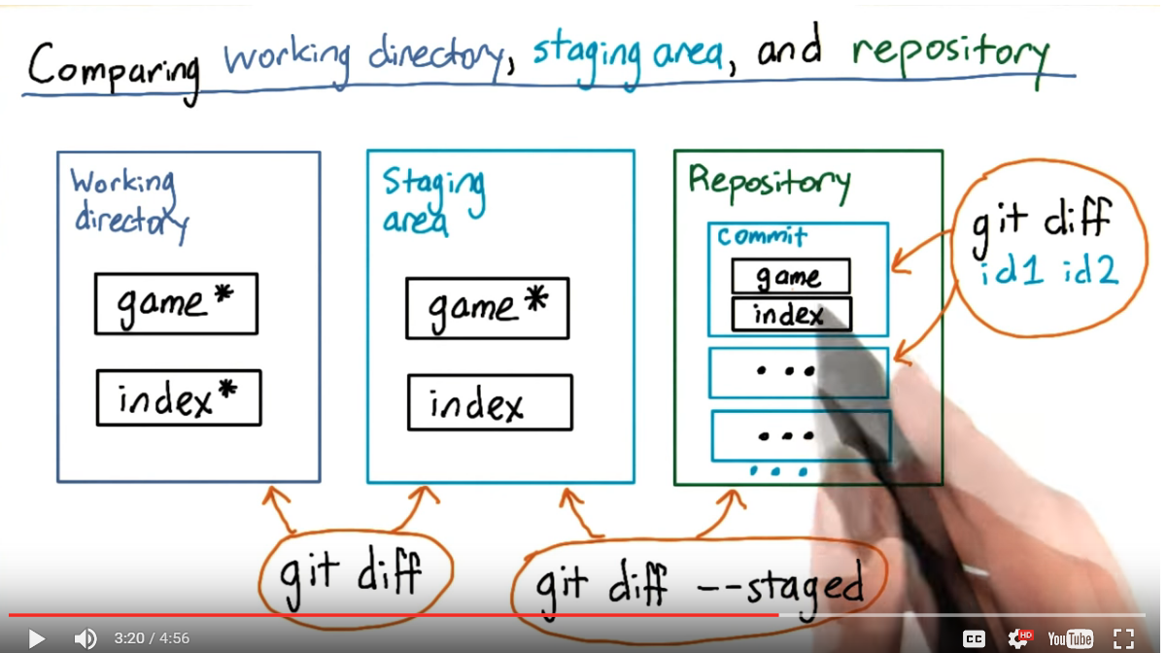

Slide 12

Thank You
happy gitting

